Slide 1
Angular Unit Testing
Tim Oleson

Slide 2
Agenda
Tools
Unit Test
Integration Tests
Best Practices

Slide 3
Mocking
Fixtures fixture = TestBed.createComponent(HeroesComponent);
Mocks mockHeroService = jasmine.createSpyObj(['getHeroes', 'addHero', 'deleteHero']);
Spies spyOn(fixture.componentInstance, 'delete');

Slide 4




Tools
Jasmine
Karma
Angular Unit Test
Jasmine(test written in)
Karma(test runner)
Browser(test viewed in)

Slide 5
Jasmine
Jasmine is a Behavior Driven Development testing framework for JavaScript. It does not rely on browsers, DOM, or any JavaScript framework.
Default integration with karma
Fakes, spies, pass-throughts
Intergration with reporting
Excellent Documentation
Jasmine GitHub
Fast low overhead, jasmine-core has now external dependencies
Out of the box you have everything you need
Node and Browser test with same framework

Slide 6
Karma
Karma is a tool for testing client-side JavaScript. Karma executes tests against your application running in a real browser, which ensures correctness and trustworthiness of test results.
Out the box Angular CLI test-runner
Watch files without restart
Excellent Documentation
Configuration
Continuous intergration

Slide 7
Karma
We can see Karma in action very quickly
// make a directory
md angular-unit-testing
// create a new angular project
ng new angular-unit-testing
// Change Directory
cd angular-unit-teating
// start the test
npm test
Notes:
// make a directory
md angular-unit-testing
// create a new angular project
ng new angular-unit-testing
// Change Directory
cd angular-unit-teating
// start the test
npm test

Slide 8
Demo
Tim Oleson
Notes:
// make a directory
md angular-unit-testing
// create a new angular project
ng new angular-unit-testing
// Change Directory
cd angular-unit-teating
// start the test
npm test

Slide 9
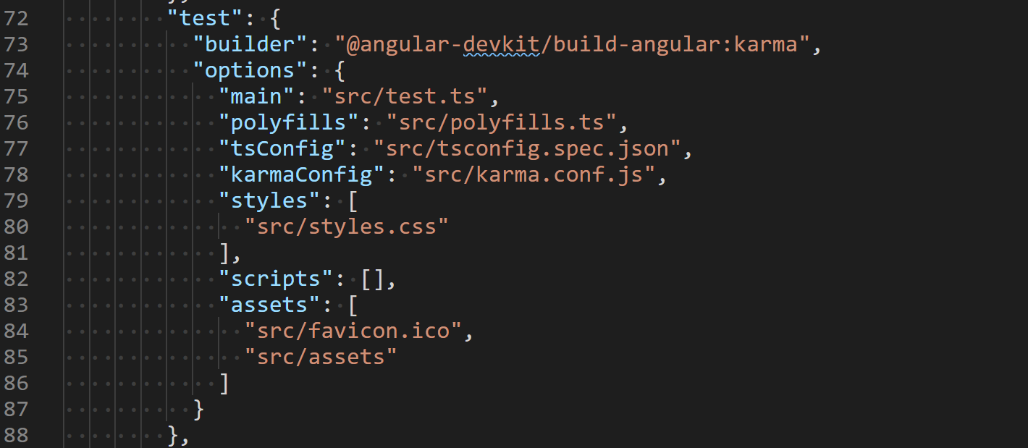
Configuration
angular.json
test.ts is the main file load all spec files from project
Karma.conf.js

Slide 10
Key Concepts
beforeEach()
TestBed
compileComponents()
NO_ERRORS_SHEMA

Slide 11
TestBed
Basic building block of angular testing module, creates a dynamically constructed test module that emulates and Angular ngModule.
import { TestBed, async } from '@angular/core/testing';
Metadata similar to ngModule
Used in the beforeEach
TestBed.configureTestingModule({
declarations: [HeroComponent],
schemas: [NO_ERRORS_SCHEMA]
});
fixture = TestBed.createComponent(HeroComponent);
});

Slide 12
complileComponents()
Async method if you need ansyc
May require two beforeEach to ensure component is complied before using it
Make sure you get the right async from core testing
import { TestBed, async } from '@angular/core/testing';

Slide 13
NO_ERRORS_SCHEMA
Ignore all unrecognized tags while testing components
Let try this out using focues test by adding f in front of the outer describe
import { NO_ERRORS_SCHEMA } from '@angular/core';

Slide 14
Unit Test
Test Behavior
Should run very fast
Should be tested in isolation
Should constant outcome pass or go
Smallest unit

Slide 15
Test Structure
Describe
It()
Expect().toBeEqual()
Arrange
Act
Assert
describe('new up instance test', () => {
it('should have name equal to', () => {
//arrange
let heroComponent = new HeroComponent();
//act
heroComponent.hero = {id: 1, name: 'SuperTim', strength: 70};
//assert
expect(heroComponent.hero.name).toEqual('SuperTim');
});
});

Slide 16
When to Test
At the beginning of development
At Completion of development
When adding new feature you should write a test first that fails
When changing a feature

Slide 17
Unit Test Types
State Test
Interaction Test

Slide 18
Component testing
Test state is expected
Mock Dependency
Use fixture.detectChanges() we need be able to detect with a change was made thru Angular built functionality
hero.component.spec.ts
Use xit() to skip a test when necessary

Slide 19
Mocking
Use Jasmine createSpyObj()
Passing in the methods of the mocked object
Provide Dependencies
mockHeroService = jasmine.createSpyObj(['getHeroes', 'addHero', 'deleteHero’]);
component = new HeroesComponent(mockHeroService);

Slide 20
Demo
Tim Oleson

Slide 21
Component Dom
Create a FakeComponent in our test
heroes.component.spec.ts
expect(fixture.debugElement.queryAll(By.css('li')).length).toBe(3);

Slide 22
Demo
Tim Oleson

Slide 23
Test pipes
strength.pipe.spec.ts
Simple to test in most cases

Slide 24
Demo
Tim Oleson

Slide 25
Events Testing
Test is a event is raised
heros.component.deep.spec.ts

Slide 26
Demo
Tim Oleson

Slide 27
Routing
RouterLinkDirectiveStub
heros.component.deep.spec.ts
hero.component.html
<a routerLink="/detail/{{hero.id}}">
<span class="badge">{{hero.id}}</span> {{hero.name}}
</a>
<button class="delete" (click)="onDeleteClick($event)">x</button>

Slide 28
Async Test
it('should call updateHero when save is called', async(() => {
mockHeroService.updateHero.and.returnValue(of({}));
fixture.detectChanges();
fixture.componentInstance.save();
// will wait until promise is completed
fixture.whenStable().then(() => {
expect(mockHeroService.updateHero).toHaveBeenCalled();
});
}))

Slide 29
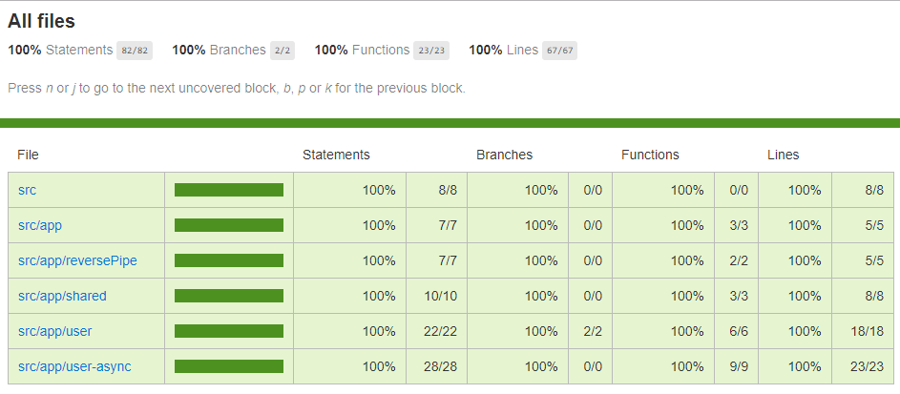
Code Coverage
ng test --code--coverage

Slide 30
Demo
Tim Oleson

Slide 31
Best Practices
- Make sure unit test runs in an isolated environment so that they run fast.
- Make sure we have at least 80% of the code coverage
- When it comes to testing services, always use spies from the jasmine framework for the dependencies this makes testing a lot faster.
- When we subscribe to observables while testing, Make sure we provide both success and failure callbacks. This will remove unnecessary errors.
- When testing components with service dependencies, always use mock services instead of real services.
- All the TestBedConfiguration should be placed in beforeEach not to repeat the same code for every test.
- while testing components, always access the DOM with debugElement instead of directly calling nativeElement. This is because debugElement provides an abstraction for the underlying runtime environment. This will reduce unnecessary errors.

Slide 32
Best Practices
- Prefer By.css instead of queryselector if you are running the app on the server as well. This is because the queryselector works only in the browser. if we are running the app on the server, this will fail. But, we have to unwrap the result to get the actual value.
- Always use a fixture.detectChanges() instead of ComponentFixtureAutoDetect. ComponentFixtureAutoDetect doesn’t know the synchronous update to the components.
- Call compileComponents() if we are running the tests in the non-CLI environment.
- Use PageObject model for reusable functions across components.
- Don’t overuse NO_ERRORS_SCHEMA. This tells angular to ignore the attributes and unrecognized tags, prefer to use component stubs.
- Another advantage of using component stubs instead of NO_ERRORS_SCHEMA is that we can interact with these components if necessary. It’s better to use both techniques together
Never do any setup after calling compileComponents(). compileComponents is asynchronous and should be executed in async beforeEach. Maintain the second beforeEach to do the synchronous setup

Slide 33
Example with longer headline text wrapping to a second line
When the headline text is 2 lines, move this text block down to align to the lower blue guide
If you don’t see guidelines, click on the View menu, and then check the box in front of “Guides”
Use a “soft return” Shift + Enter to wrap text without adding extra line spacing

Slide 34
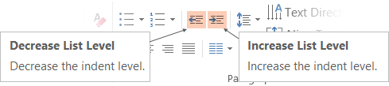
Adjusting list levels
Main topic: Segoe UI, size 28pt
Segoe UI, size 20pt for second level
Segoe UI, size 16pt for third level
Use the “Decrease List Level” and “Increase List Level” tools on the Home menu to change text levels.
Try this:
Place your cursor in the line of text that says “Segoe UI, size 20pt for second level”
Next click the Home tab, and then on the “Decrease List level” tool. Notice how the line moves up one level.
Now try placing your cursor in one of the top “Main topic…” line of text. Click the “Increase List Level” tool and see how the text is pushed in one level.
Use these 2 tools to adjust your text levels as you work

Slide 35
Bullet points layout with subtitle Set the subtitle to 20pt in the same text block, with character spacing Normal
Move the text block down vertically to align to lower guide
If you don’t see guidelines, click on the View menu, and then check the box in front of “Guides”
Hyperlink style: www.microsoft.com

Slide 36
Title square photo layout
Smaller text

Slide 37
Square photo layout

Slide 38
Side-by-side photo layout
Text placeholder
Text placeholder

Slide 39
Three photos layout
Text placeholder
Text placeholder
Text placeholder

Slide 40
Four photos layout
Text placeholder
Text placeholder
Text placeholder
Text placeholder

Slide 41
Top photo with Title

Slide 42
Full bleed photo with Title

Slide 43
Slide palette info
The PowerPoint palette for this template has been built for you and is shown below.
Avoid using too many colors in your presentation.
PowerPoint Theme Accent colors
Accent 1
Accent 2
Accent 3
Accent 4
Accent 5
Accent 6
Use Accent 1 as the main accent color.
Use Accent 2 and Accent 3 only when additional colors are needed.
Use Accents 4-6 sparingly

Slide 44
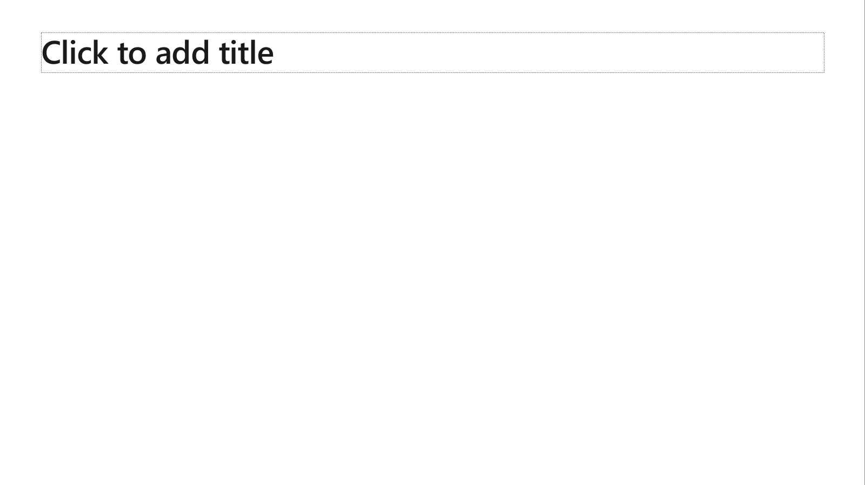
Ensure slide content is accessible
Take the following steps to create accessible content that everyone can consume effectively.
Contrast
Use high contrast colors for maximum readability
The recommended contrast ratio is at least 4.5:1
Shape and color
Use different shapes with a legend to indicate statuses to accommodate for color blindness
Example:
Alt text
Alt text helps people with screen readers understand the content of slides
You should create alternative text for shapes, pictures, charts, tables, SmartArt graphics, or other objects
Here’s how:
Right click on item
Select Edit Alt Text
Enter a Description
If an object is meant to add visual styling and doesn’t contain meaning (e.g. stylistic borders), do not add alt text and instead check Mark as decorative
Slide layouts
Using a built-in slide layout that matches your content ensures a hierarchical reading order of text blocks
Example:
If a new slide will have a title, rather than starting with a blank layout and adding a text block for the title, choose one of the built-in layouts with a title placeholder
Reading order
Screen readers describe content on the screen in the order it was created
To ensure your content is read back in the order you prefer, arrange your objects in the Selection Pane appropriately. Objects on the bottom of the selection pane are read first
Here’s how:
Click the Home tab
In the Drawing group, select the Arrange drop-down menu
Click Selection Pane…
Subject 1
Subject 2
Subject 3
Color Contrast Analyzer
Download this tool to determine the legibility of text and the contrast of visual elements
Download
C1
C2
C3
Additional tips
Be sure to run the Accessibility Checker! Go to File click the Check for Issues drop down menu click Check Accessibility
Videos need to be accessible: If your presentation includes a video, ensure it is captioned and audio described (if appropriate)
Visit the Office Accessibility Center to learn more about accessibility in PowerPoint

Slide 45
Brand and accent colors accessibility
Type and background combinations must meet a minimum 4.5:1 contrast ratio to help ensure people of all abilities can access and understand our communications.
Pick colors carefully and avoid relying on color alone to convey information. Always provide text or other graphical cues to guide customers to our message.
Examples demonstrate correct color use for on-screen applications.
Get the Color Contrast Analyzer
Get more information on accessibility
Get the Microsoft color guidelines PDF
Dark Orange
Rich Black
R255 G147 B73 Hex #FF9349
Dark Yellow
Rich Black
R254 G240 B0 Hex #FEF000
Dark Green
Rich Black
R155 G240 B11 Hex #9BF00B
Dark Teal
Rich Black
R48 G229 B208 Hex #30E5D0
Dark Blue
Rich Black
R80 G230 B255 Hex #50E6FF
Dark Purple
Rich Black
R213 G157 B255 Hex #D59DFF
White
Rich Black
R216 G59 B1
Hex #D83B01
Rich Black
R255 G185 B0
Hex #FFB900
White
R16 G124 B16
Hex #107C10
White
Rich Black
R0 G133 B117
Hex #008575
White
Rich Black
R0 G120 B212
Hex #0078D4
White
Rich Black
R134 G97 B197
Hex #8661C5
Light Orange
White
R107 G41 B41 Hex #6B2929
Light Yellow
White
R106 G75 B22 Hex #6A4B16
Light Green White
R5 G75 B22 Hex #054B16
Light Teal
White
R39 G75 B71 Hex #274B47
Light Blue
White
R36 G58 B94 Hex #243A5E
Light Purple
White
R59 G46 B88 Hex #3B2E58
White
R255 G255 B255
Hex #FFFFFF
Orange
Dark Orange
Dark Yellow
Green
Dark Green
Teal
Dark Teal
Blue
Dark Blue
Purple
Dark Purple
Rich Black
R0 G0 B0
Hex #000000
White
Light Orange
Orange
White
Light Yellow
Yellow
White
Light Green
White
Light Teal
Teal
White
Light Blue
Blue
White
Light Purple
Purple
Extra Light Gray
R242 G242 B242
Hex #F2F2F2
Light Gray
R230 G230 B230
Hex #E6E6E6
Gray
R210 G210 B210
Hex #D2D2D2
Mid Gray
R115 G115 B115
Hex #737373
Dark Gray
R80 G80 B80
Hex #505050
Extra Dark Gray
R47 G47 B47
Hex #2F2F2F

Slide 46





PowerPoint Design Ideas
Get suggestions for slides
PowerPoint Designer can create suggestions for your slide content.
To access Design Ideas, click the “Design” tab in the Ribbon and then “Design Ideas” on the right.
Designer will also trigger when you insert an image.

Slide 47

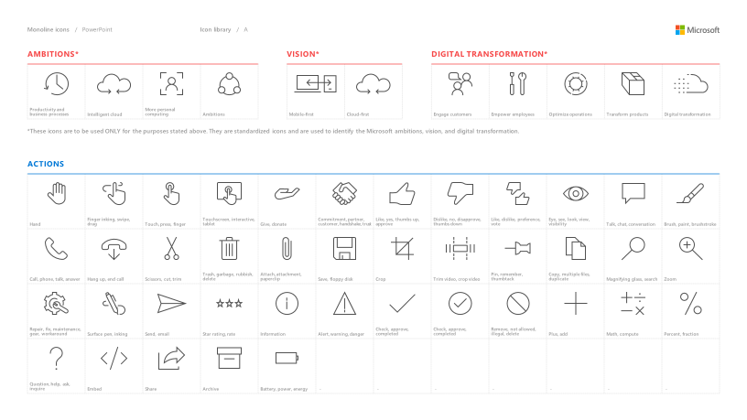
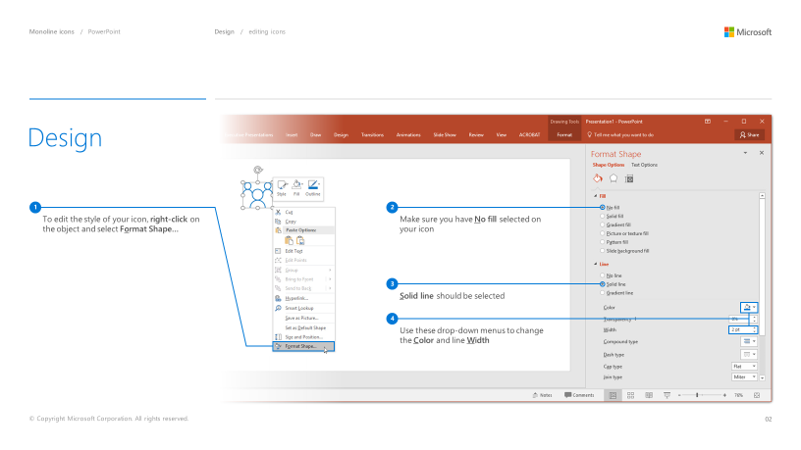
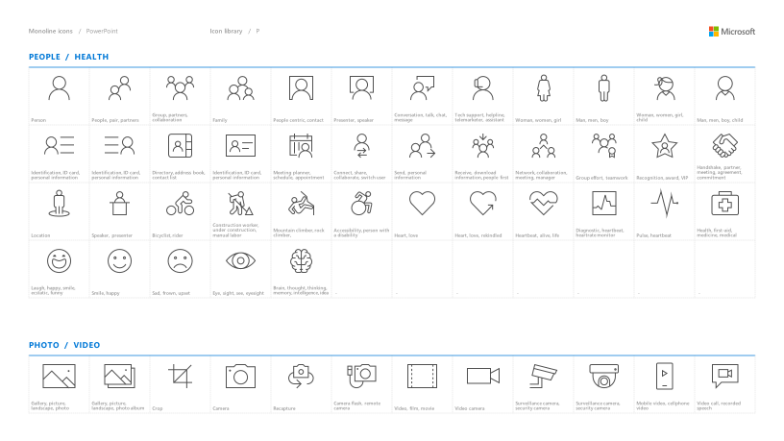
Microsoft monoline icons
Looking for icon resources?
The Monoline icon library for PowerPoint is a slide deck that provides a library of icons for use in PowerPoint presentations.
The Monoline icon style guide for PowerPoint is a pdf with additional guidelines.
Download both from Brand Central.

Slide 48
Questions?

Slide 49
Software code slide
This slide layout uses Consolas, a monotype font which is ideal for showing software code.

Slide 50
Notes (hidden)
Some speakers at Microsoft like to use this slide for hidden “notes slides”.
Delete it if you don’t want to use it.
NEXT: <next slide title>

